Slide 1

MegAITex
AI-Powered Pathology Diagnostics
Transforming oncological diagnostics
with 95-97% accuracy and 98% recall
CONFIDENTIAL

Slide 2








Problem Statement
The Challenge
Diagnostic Complexity
Cancer diagnosis is complex due to the rarity, diversity, and heterogeneity of tumors. Current processes are time-consuming, labor-intensive, and prone to expert disagreement.
Difficult differentiation between benign and low-grade malignant tumors
Time-Consuming Process
Manual examination of histological slides is labor-intensive and slow
The Gap
There's a significant gap in industrial solutions for automated AI-driven recognition of morphological and histological images, with a lack of high-quality, open-access datasets.
Expert Disagreement
Multiple expert pathologists often disagree on diagnosis
Data Limitations
Lack of high-quality, open-access datasets for AI training

Slide 3
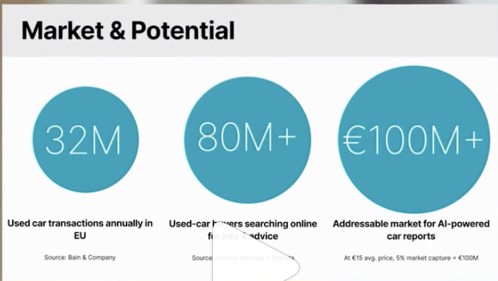






Market Opportunity*
$65B
$32B
$19M
$10M
Market size, 2024
$1B
Forecast 2033
$0.5B
Mexico
US
Global
* Grand View Horizon
AI Pathology Segment
Growth Timeline
Target the specific AI pathology market within the broader biopsy market
Projected market growth through 2033 creates a clear timeline for strategic planning
Market Expansion
MegAITex Opportunity
Position as a wedge into the larger pathology and precision oncology markets
Focus on high-growth potential while established players address broader markets

Slide 4
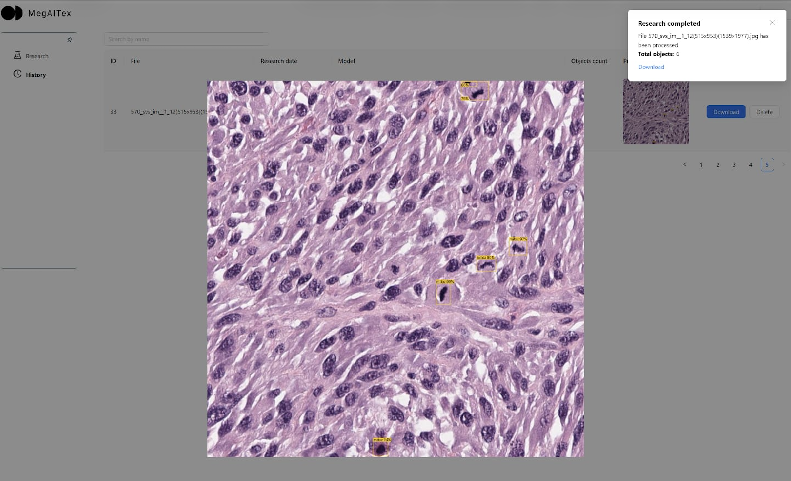
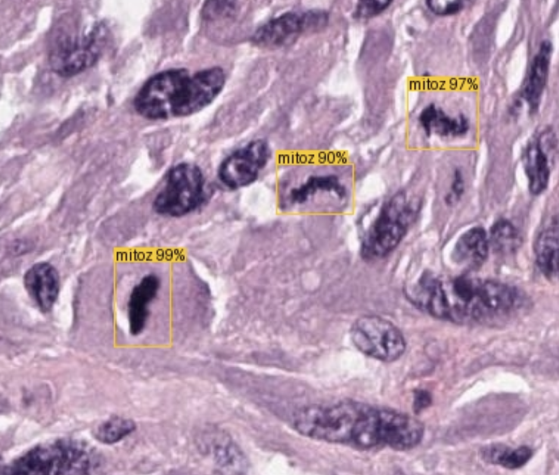













Our Solution
AI-Powered Diagnostic Assistant
MegAITex's innovative software assists pathologists in differential diagnosis with high-throughput, automated image analysis of digitized histological slides.
Key Technology Components
Enhanced Detection
Accuracy
ResNet-50 Architecture
Feature Pyramid Network
Minimizes human errors and expert disagreement
High-throughput analysis with 95-97% precision and 98% recall
Our solution uses ResNet architecture with residual blocks for robust feature extraction and can process massive histological images (up to 1.5 GB) by segmenting them into tiles.
Efficiency
Novel Approach
Significantly reduces workload and analysis time
Specialized for atypical mitosis detection

Slide 5



Traction & Validation
Functional Test
95-97%
98%
Precision
Recall
Dataset Validation
Benchmark Performance
Tested on public datasets including MITOS2012
Improved detection of pathological mitoses compared to published AI models
Expert Validation
Clinical Agreement
Trained and modified using a unique collection of images saved over 40 years in oncology diagnostics
AI model achieved high agreement between different diagnoses in clinical testing

Slide 6


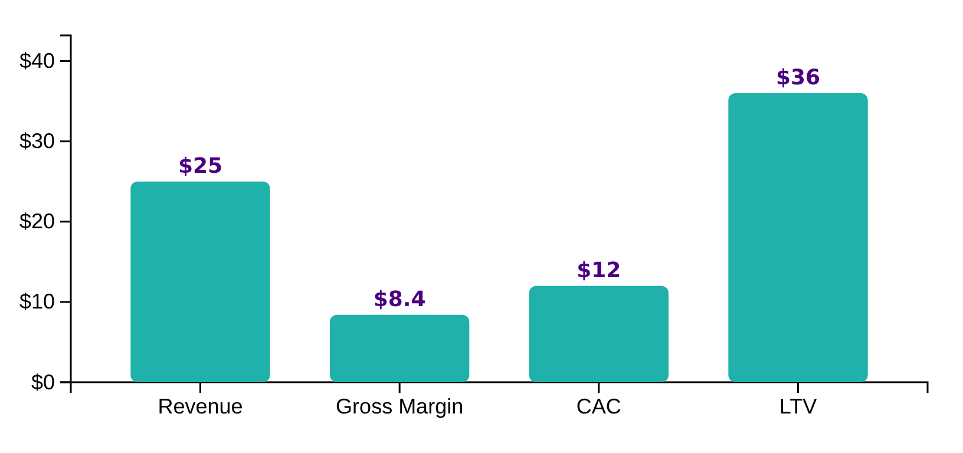




Business Model & Unit Economics
Unit Economics
Gross Margin
Margin per Case
$8.40 gross margin at scale
Path to Profitability
Breakeven point
Launch
6 months
12 months
18 months
24 months
Pricing Strategy
Case Pricing
Initial focus on Mexico with $25 per case
Profitability Target
18-24-month breakeven expectation
Competitive Advantage
Cost-effective solution compared to traditional diagnostics
7 / 12

Slide 7
Legend:
Revenue ready
Go-To-Market Strategy
R1, R2 - Release 1, Release 2
We are here
Product
is ready
As soon as funded
6 months after funding
10 months after funding
13 months after funding
16 months after funding
19 months after funding
Product is ready for clinical approbation
Partnership with company with access to the Mexico State and Private Medical institutions to sell our service to our consumers.
LAUCNH IN MX
R2 – Discovery
Become the trusted AI co-pilot for pathologists in Mexico
LAUNCH PILOT
IN US
R2 – Validation (US)
LAUNCH IN US
R1 – Clinical trial (US)
R2 – Development
Become the trusted AI co-pilot for pathologists in US
LAUNCH GLOBALLY
PUBLICATION in the scientific journals
PARTNERSHIP in Mexico, US with:
  Insurance Companies,
  Medical Institutions
  Large hospital pathology labs.
  Reference labs (Quest Diagnostics, LabCorp).
  Academic research institutions.

Slide 8
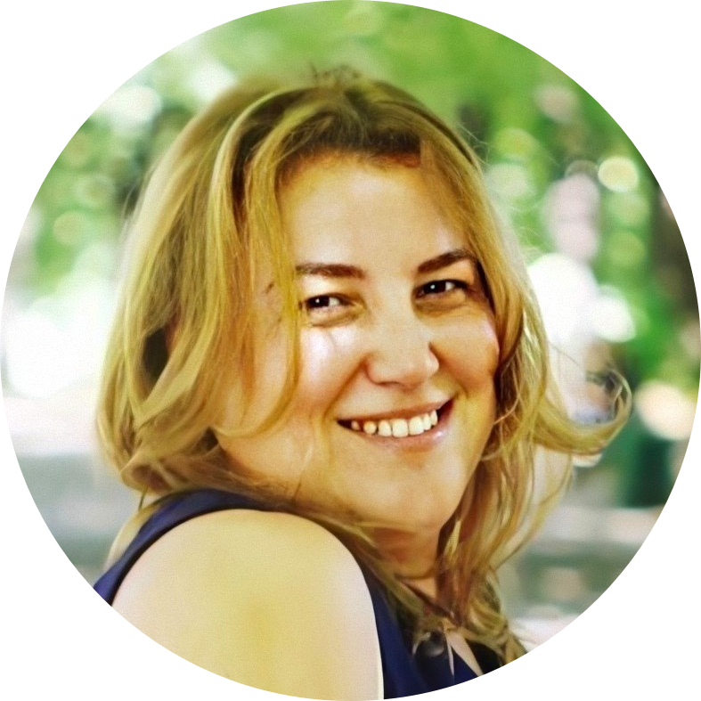
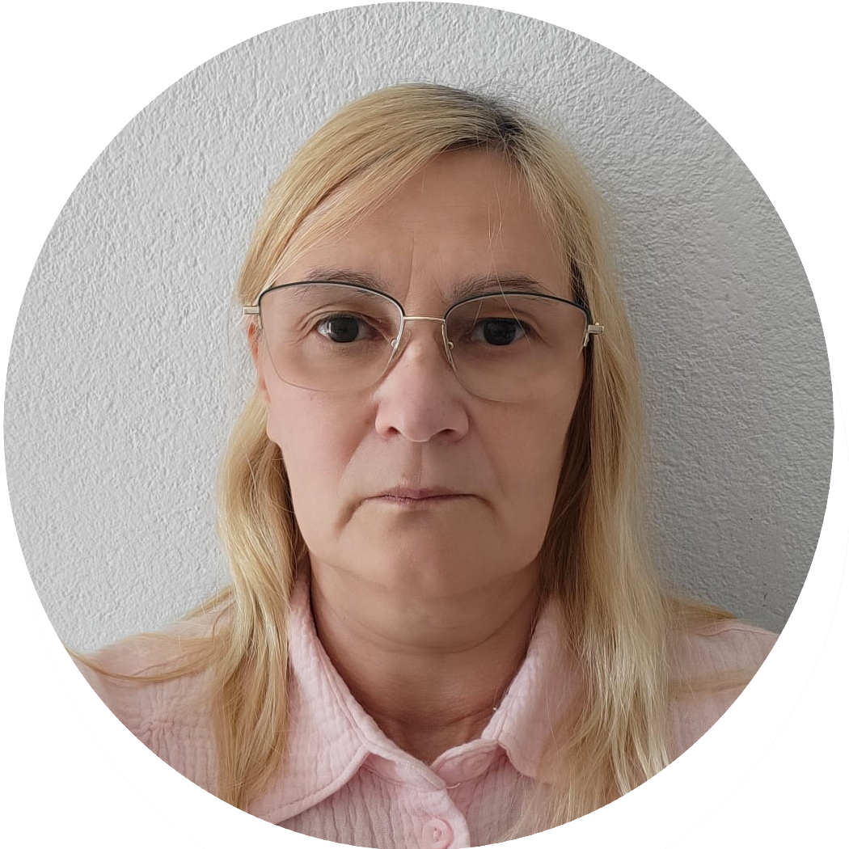
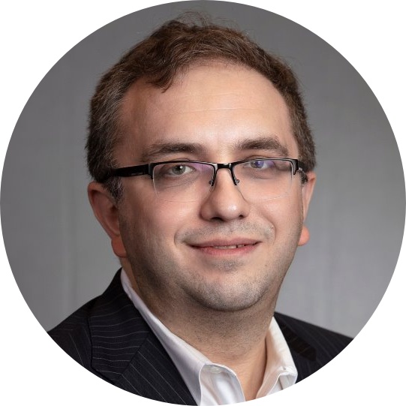
Core Team
Helen Martsynishena
Nina Fedosova
Boris Khazin
Chief Executive Officer
Chief Technology Officer
Chief Financial Officer
An experienced technology executive with 20+ years of experience delivering complex AI and intelligent automation solutions across Banking, Retail, Software, and High-Tech industries.
Excels in leading global teams, driving business growth.
AI architect and expert with extensive experience in developing mathematical models and integration solutions.
Author of scientific publications and holder of the OPEN Group Certified Architect certification.
Won grant for successful AI in MedTech MVP.
Seasoned executive and board advisor with over 20 years of leadership experience as well as developing AI-driven digital resilience.
Has a proven track record of guiding global enterprises and fintech startups, technology transformation, operational and financial scaling.
Successfully built and scaled multimillion-dollar practices and pioneered AI-based compliance solutions in collaboration with industry leaders like Google and Microsoft.

Slide 9



Finance Projections
$29M
$24M
$7M
Revenue
$4M
Expenses
$174k
EBITDA
$2.2M
$2M
$3M
$4.5M
Year 1
Year 3
Year 5
Revenue Growth
Break-even
Gross Margin
Projected ARR with monthly case volume targets
Expected by 18-24 months with $4.25M investment
Maintaining $8.40 gross margin at scale

Slide 10
Competitive Advantage
Competitive Matrix
MegAITex Key Advantages
Feature | MegAITex | Paige | PathAI
Accuracy | 95-97% precision, 98% recall (all cancer types) | 93–98% (in prostate studies only) | ~96.6%, specificity ~98% in reported studies; performance varies by indication,
Dataset | 5k+ cases of clinical diagnostics with verified diagnosis, reviewed and validated by the expects pathologist. | 4M+ slides from 1,000+ institutions | 551k slides
Detection Focus | Atypical mitosis | Cell identification | Cell identification
Unique Value | Different cancer on the early stage, low grade recognition | FDA‑cleared prostate AI plus broad multi‑cancer diagnostic suite | Pan‑cancer pathology AI with strong pharma partnerships and biomarker/clinical‑trial optimization focus
Estimated Revenue, 2025 |  | 30M, Tempus expects its $81.25m acquisition | 100M
MegAITex differentiates itself through its superior accuracy, unique 40-year oncology dataset, specialized atypical mitosis detection, and lower false-positive burden compared to competitors.

Slide 11


Funding Request
Total Funding Request
Key Outcomes & Milestones
$4.25M+
Mexico Launch
Strategic Partnerships
clinical trial costs
Achieve COFEPRIS clearance and launch commercial operations in Mexico
Form key partnerships with hospital systems and diagnostic centers
US FDA Submission
Scale to 10K Monthly Cases
Prepare and submit FDA application for regulatory approval
Expand operations to achieve 10,000 monthly diagnostic cases
Key Performance Indicators
 | Year 1 | Year 2
Number of slides | 7250 | 100250
Revenue | $174k | $2.4M
11 / 12

Slide 12
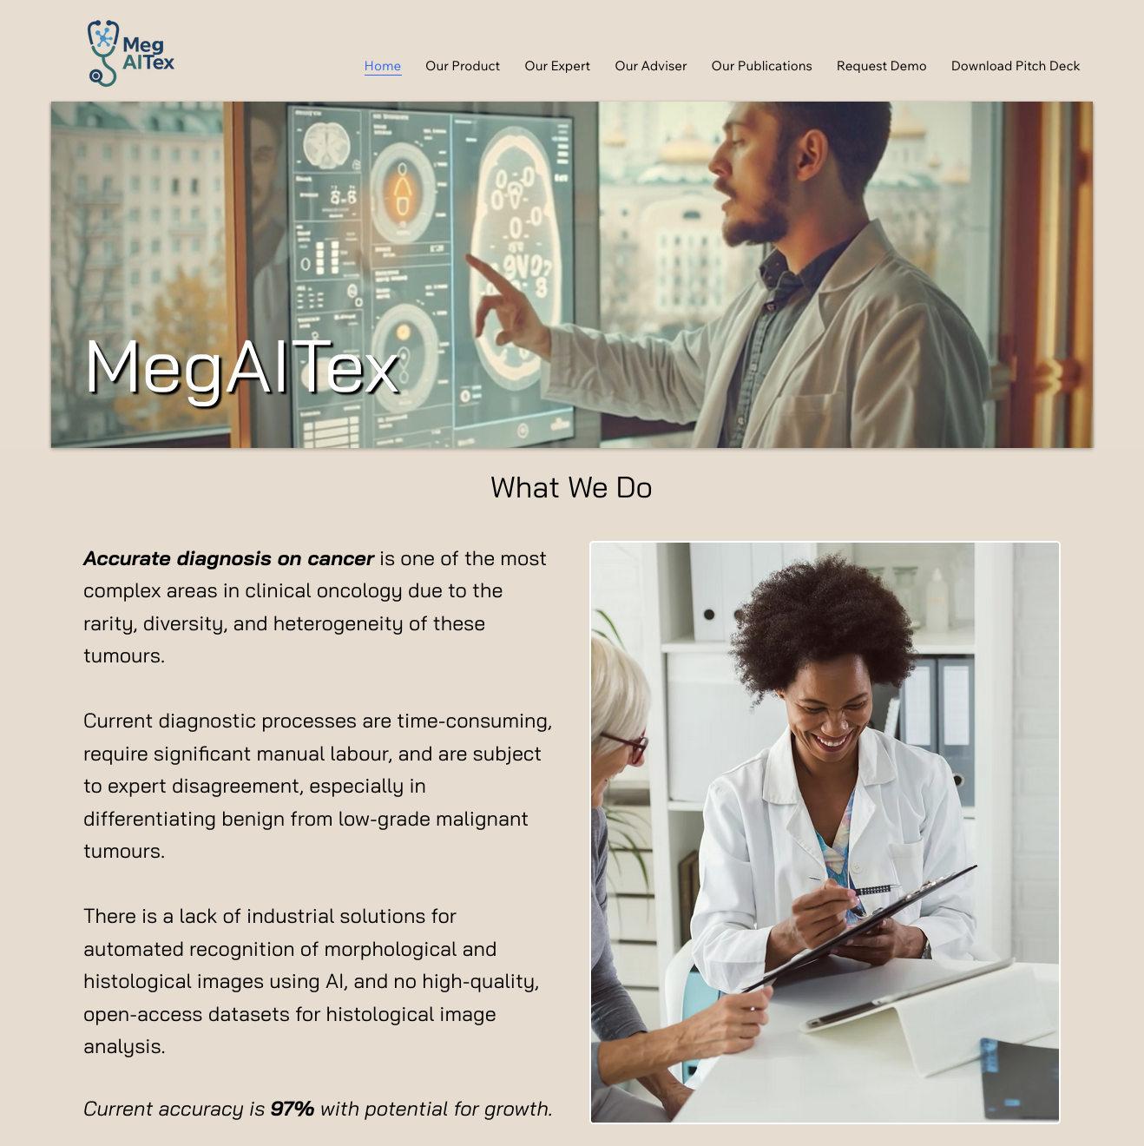
Thank you
Feel free to request demo or contact us in case of any questions: Sales@MegAITex.com
Our site https://www.megaitex.com/

