Slide 1


Megaitex

Slide 2
1
PROBLEM
STATEMENT
Accurate diagnosis on cancer is one of the most complex areas in clinical oncology due to the rarity, diversity, and heterogeneity of these tumors.
Current diagnostic processes are time-consuming, require significant manual labor, and are subject to expert disagreement, especially in differentiating benign from low-grade malignant tumours.
There is a lack of industrial solutions for automated recognition of morphological and histological images using AI, and no high-quality, open-access datasets for histological image analysis.

Slide 3
2
solution
We developed an AI-powered software prototype to assists pathologists in the differential diagnosis of oncological diseases.
Our solution leverages deep learning (ResNet architecture with residual blocks) to automate the detection of pathological mitoses and other key features on digitized histological slides.
The system enables high-throughput, automated image analysis, reducing workload, increasing diagnostic accuracy, and minimizing human errors.
Current model characteristics (based on the functional assessment. Clinical trial is still to be done):
      Precision = 96%
      Recall = 98%
      Accuracy = 97%

Slide 4
3
TECHNOLOGY AND INNOVATION
Neural Network Architecture
Utilizes ResNet-50 and Feature Pyramid Network (FPN) for robust feature extraction and small object detection on large-scale images.
Data Processing
Handles massive histological images (up to 1.5 GB), segments them into manageable tiles for efficient analysis.
Novelty
Focuses on object detection (not just classification or segmentation), overcoming limitations of existing AI models in clinical practice.

Slide 5
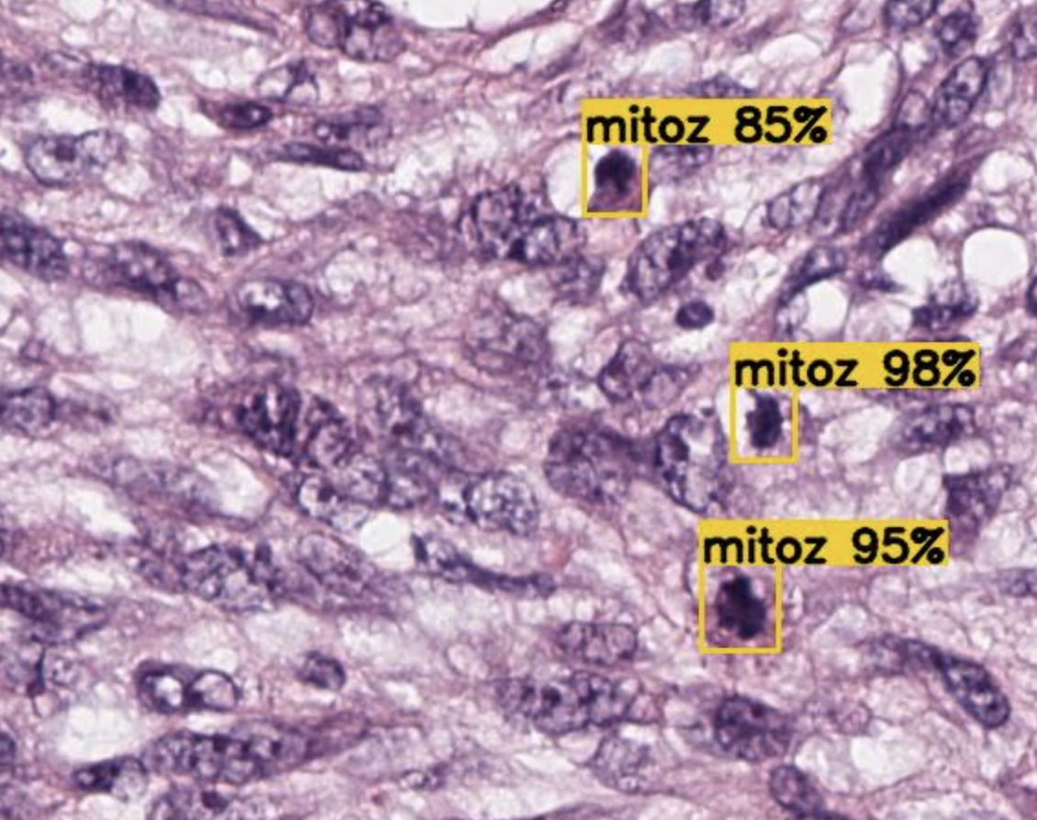
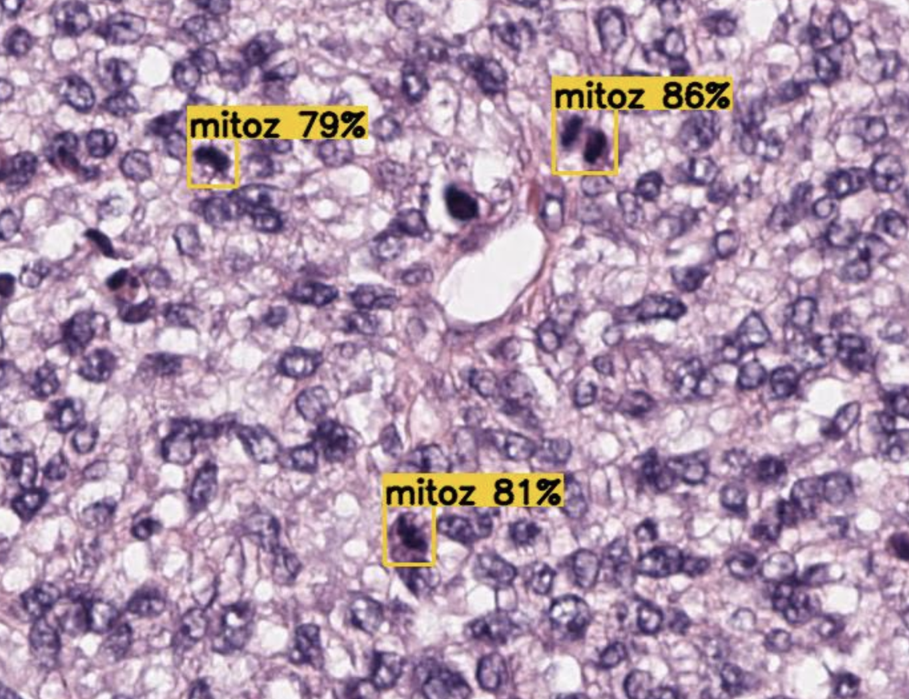
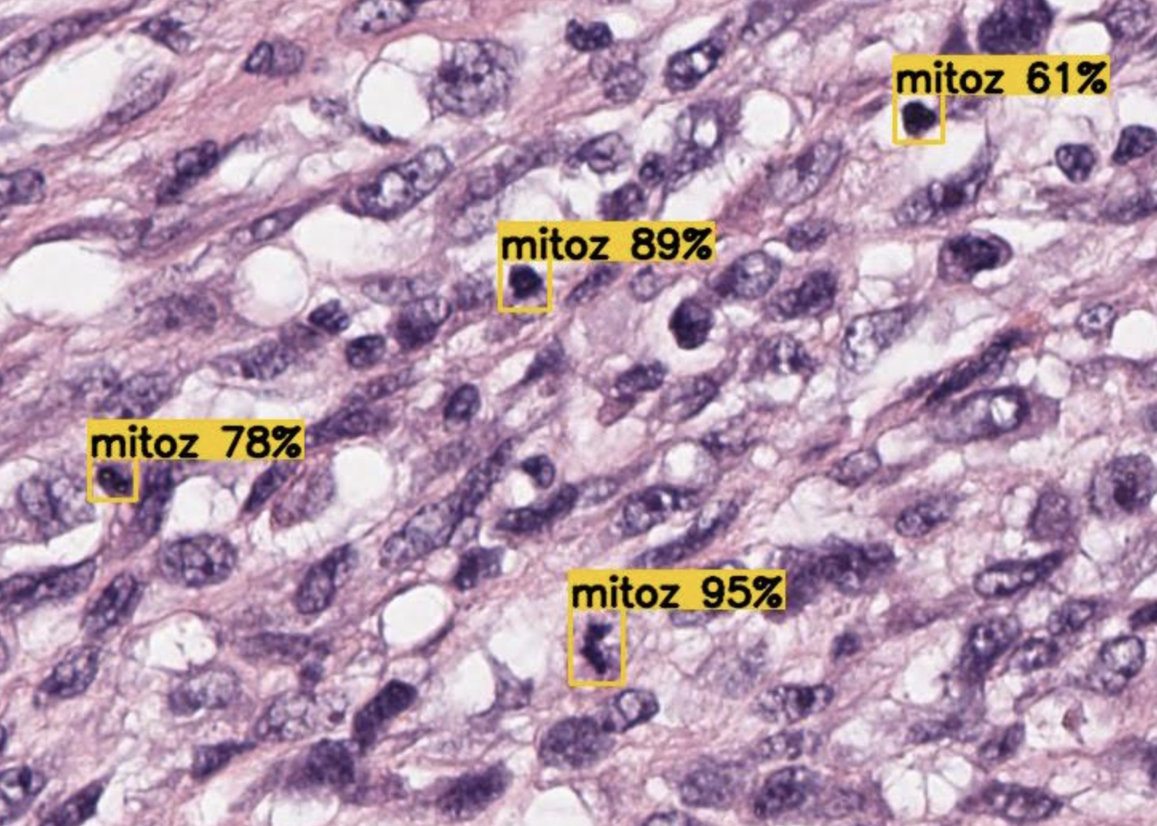
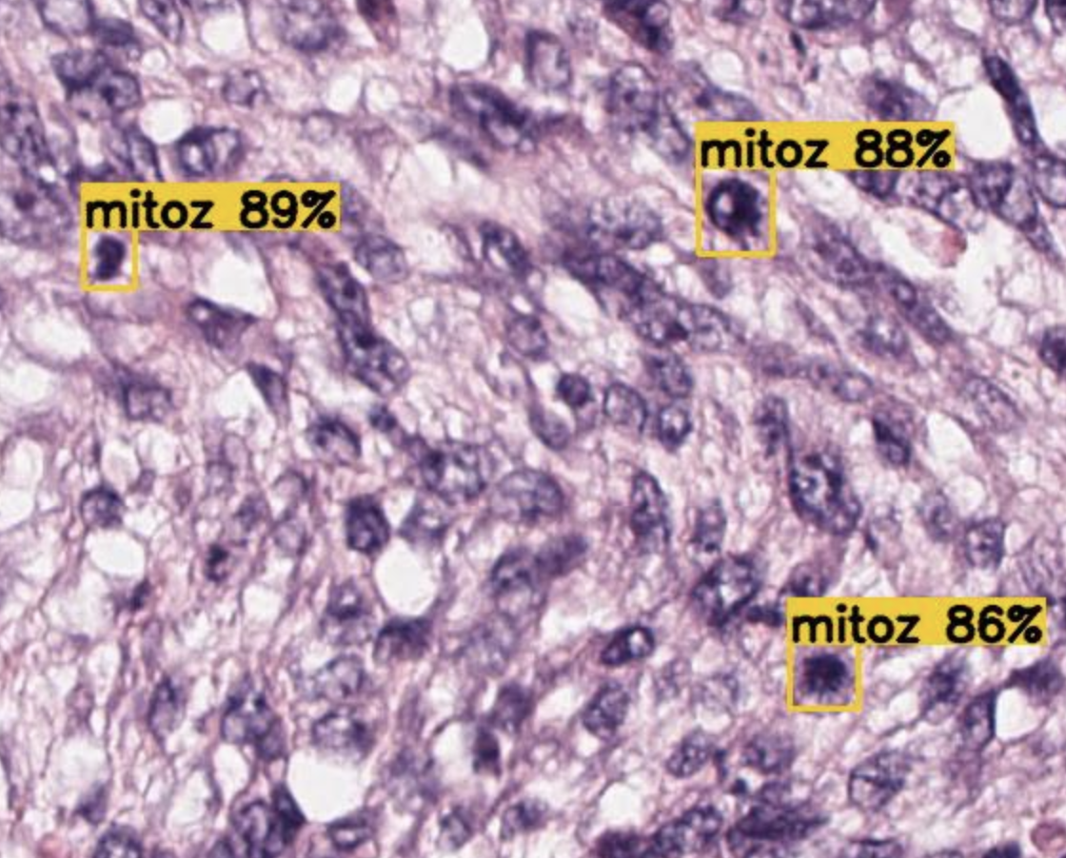
UNIQUE VALUE PROPOSITION
Innovative AI model development approach for the atypical mitoses* detections.
A fundamental distinction of our solution are graphics processing technologies and specially developed mathematical methods for object detection with Medical science and experts' engagement.
Our technology uses advanced ML architecture improved and trained as a new model which enhanced and customized for other fields of medicine diagnostics.
Developed mathematical model was tested in State Medical Institution and further fine-tuned to minimize the number of false positives. For this purpose, individual categories of images that appeared “similar” from the model’s perspective were separated into subcategories.
Current accuracy is 97% with potential for growth.
*Atypical mitosis is a disruption of the normal process of cell division (called mitosis), which leads to abnormal distribution of genetic material between the two new cells. As a result, the daughter cells may receive an unequal number of chromosomes or have chromosomal abnormalities.
Atypical mitosis can occur after exposure to mitotic poisons, toxins, or extreme conditions such as ionizing radiation, lack of oxygen (anoxia), or low temperatures (hypothermia). It may also happen during viral infections or in tumours. A sudden increase in the number of pathological mitoses is a typical sign of malignant (cancerous) tumours.

Slide 6
development roadmap (High Level)
MVP (completed):
Proven Technology
Release 1:
Near-Term Execution
Release 2:
Long-Term Scale
Market Opportunities:
Massive Upside
4 months after funding
13 months after funding
Breakthrough accuracy in detecting pathological mitoses, validating core innovation.
Current model characteristics:
Precision = 96%
Recall = 98%
Accuracy = 97%
Real-time, multi-cancer diagnostics with advanced biomarker detection (e.g., Ki-67).
Market: Mexico, US
Secure, regulatory-ready platform enabling first clinical adoption
Market: Mexico
Positioned to lead AI-powered pathology and capture multi-billion precision medicine markets.

Slide 7
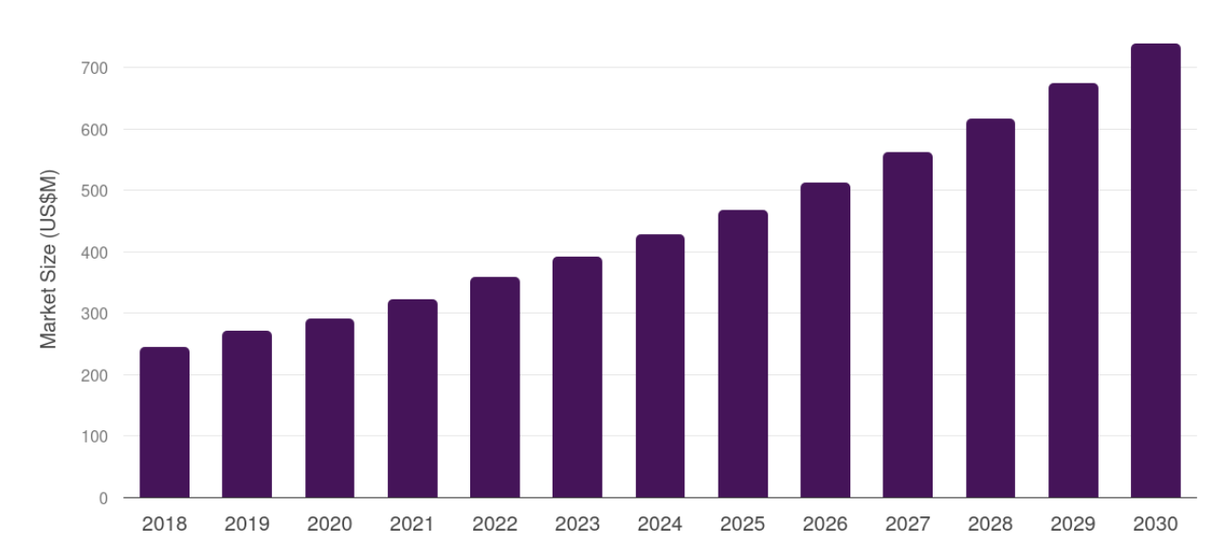
MEXICO Market opportunities
4
REVENUE, 2023, US$M – 392.4
FORECAST, 2030, US$M – 739.0
CAGR, 2024-2030 – 9.5%
MEXICO CANCER BIOPSY MARKET, 2018-2030 (US$M)*
In terms of REVENUE, Mexico accounted for 1.3% of the global cancer biopsy market in 2023.
Country-wise, U.S. is expected to lead the global market in terms of revenue in 2030.
In Latin America, Brazil cancer biopsy market is projected to lead the regional market in terms of revenue in 2030.
Mexico is the fastest growing regional market in Latin America and is projected to reach USD 739.0 MILLION BY 2030.
Lack of industrial-grade AI tools for histopathological image analysis creates a significant market gap.
* Grand View Horizon

Slide 8
Our POTENTIAL consumers/PARTNERS in MEXICO
RESEARCH MEDICAL INSTITUTIONS
MANUFACTURERS OF MEDICAL EQUIPMENT AND ANALYTICAL SYSTEMS
Instituto Nacional de Cancerología (INCAN)
INCMNSZ "Salvador Zubirán”
Unidad de Investigación Biomédica en Cáncer - INCan/ UNAM
Olympus (Evident) & Leica
Philips, Roche, Leica
Zeiss, Thermo Fisher, Olympus
INSURANCE COMPANIES
MEDICAL INSTITUTIONS SPECIALIZING IN DIAGNOSTICS
Grupo Nacional Provincial (GNP)
AXA Seguros
Mapfre México
Instituto Nacional de Cancerología (INCAN)
Instituto Nacional de Ciencias Médicas y Nutrición "Salvador Zubirán" (INCMNSZ)
Medica Sur

Slide 9
US Market opportunities
REVENUE, 2023, US$M – 9753.6
FORECAST, 2030, US$M – 15849.1
CAGR, 2024-2030 – 7.2%
* Grand View Horizon
The U.S. cancer biopsy market generated a REVENUE of USD 9,753.6 million in 2023 and is expected to reach USD 15,849.1 million by 2030.
The U.S. market is expected to grow at a CAGR of 7.2% from 2024 to 2030.
In terms of segment, kits and consumables was the largest revenue generating product in 2023.
Instruments is the most lucrative product segment registering the fastest growth during the forecast period.
In terms of revenue, U.S. accounted for 32.5% of the global cancer biopsy market in 2023.
Country-wise, U.S. is expected to lead the global market in terms of revenue in 2030.
In North America, U.S. cancer biopsy market is projected to lead the regional market in terms of revenue in 2030.
U.S. is the fastest growing regional market in North America and is projected to REACH USD 15,849.1 MILLION BY 2030.

Slide 10
5
COMPETITIVE
ADVANTAGES
Clinical Relevance
Developed in close collaboration with pathologists, ensuring practical applicability and integration with clinical workflow.
Superior Accuracy
Reduces false positives/negatives through
advanced model training and continuous improvement.
Scalability
Automated, high-throughput processing suitable for large pathology labs and research centres.
Unique Dataset Strategy
Addresses the lack of quality histological datasets
by developing proprietary data pipelines and annotation protocols.

Slide 11
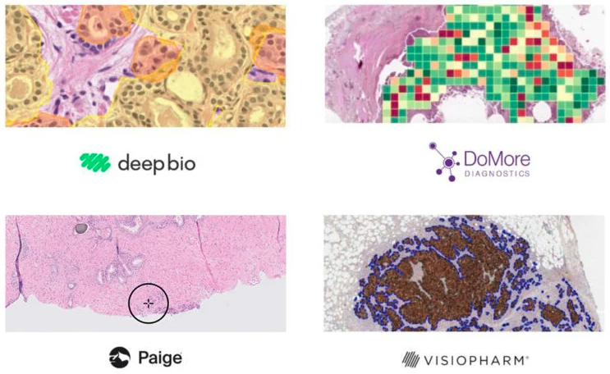
Competitors Landscape
Pure‑Play Pathology AI | Competitors | MegAITex
Paige | 1. AI method: Image Classification* 2. Method key steps description: Images segmentation Segments comparison with original example of tumor 3. Conclusion: Image Comparison method does not used by Pathologists expert due to low level of precision and accuracy/ Image comparison method is recommended and used by medical interns as the simplest. | 1. AI method: Image Detection** 2. Method key steps description: Object (tumor) patterns determination Train AI math model based on determined patterns 3. Conclusion: Patterns-based diagnostics method is used by top level medical experts especially for complex and controversial cases We consider Image Classification method as the unscientific and trivial method
PathAI
Ibex Medical Analytics
Aiforia / DeepBio
Imagene AI / Owkin
Platform marketplaces (HALO AI, Concentriq AI)
MegAITex - https://www.megaitex.com/
Paige - https://www.paige.ai/
PathAI – https://www.pathai.com/
Ibex Medical Analytics – https://ibex-ai.com/
Aiforia / DppeBio – https://www.aiforia.com/ ;
Imagene AI / Owkin – https://imagene-ai.com/ ; https://www.owkin.com/
HALO AI – https://indicalab.com/halo-ai/
Concentriq AI – https://proscia.com/concentriq-platform/
Image Classification* - comparing images
Image Detection** - searching for objects in an image

Slide 12
Moat & Differentiation
UNIQUE DATA ADVANTAGE
ATYPICAL MITOSIS
DETECTION STRENGTH
LOWER FALSE‑POSITIVE BURDEN
Access to atypical/ under‑represented cohorts and expertly adjudicated ground truth; continuous feedback loop from clinical deployments.
Model architecture and curation emphasize rare/edge‑case mitoses; sensitivity without saturating pathologists with false alarms.
Guardrails + calibrated thresholds + QA (quality assurance) filters reduce noise, increasing trust and pathologist throughput.
FASTER READS /
PER‑CASE ECONOMICS
BUNDLED VALUE (example)
DEFENSIBILITY
Workflow integration (triage, pre‑annotations, QA flags) lowers minutes per case and supports higher daily volume.
Ki‑67 quantification + mitosis detection + QA/quality flags as a single SKU—priced to improve per‑case margins vs. point solutions.
Regulatory pathway, clinical validation, and continuous post‑market monitoring; tooling for evidence generation (model cards, bias/robustness).

Slide 13
6
TRACTION
AND
VALIDATION
Prototype tested on public datasets (e.g., MITOS2012), with results benchmarked against published AI models.
Demonstrated improved detection of pathological mitoses compared to existing solutions.
We use object detection model, which was trained and modified used unique collection of images saved for 40 years of work in oncology diagnostic.
We use our knowledge in mathematics to improve convolutional neural network * architecture and experience in medicine to implement it.
*Convolutional neural network (CNN) - type of artificial neural network designed to process data with a grid-like structure, such as images. It automatically learns to detect simple patterns (like edges or textures) in early layers and combines them into complex structures (like objects or scenes) in deeper layers, making it highly effective for tasks like image recognition, video analysis, and even speech processing.

Slide 14
7
Regulatory pathway
(US/MX) & QMS
DUAL-MARKET STRATEGY: Initial launch in Mexico (COFEPRIS) followed by U.S. FDA submission
CLINICAL VALIDATION: Completed by Q2 2026 targeting key metrics for sensitivity and specificity
MEXICO SUBMISSION: COFEPRIS regulatory dossier ready by Q2 2026, clearance anticipated by Q3 2026
U.S. FDA SUBMISSION: Planned for Q3 2026 under 510(k) or De Novo pathway, aiming for clearance in 2027
COMPLIANCE FOCUS: Meets international standards ISO 13485 & IEC 62304; incorporates GMLP and lifecycle management
POST-MARKET: Ongoing quality management system (QMS) and real-time performance monitoring
KEY BENEFITS: Accelerated market entry with validated AI-driven pathology solution backed by robust regulatory framework

Slide 15
8
Business model
We are asking for $4.250mm + clinical trial fee. Multi country release would require higher investment.
First target country – Mexico.
We are expecting to break even on the P&L at around 18-24 months. This is based on a one country (Mexico) release.
Data Partnership
Collaborations with medical institutions to expand and refine training datasets.

Slide 16
GO-TO-MARKET
9
Complete
As soon as funded
4 months after funding
10 months after funding
13 months after funding
16 months after funding
MVP is ready for clinical approbation
Partnership with company with access to the Mexico State and Private Medical institutions to sell our service to our consumers.
R1 – Clinical trial (US)
R1 – Clinical usage (Mexico)
R2 – Discovery
Become the trusted AI co-pilot for pathologists in Mexico
R2 – Development
R2 – Validation (US)
R2 – Clinical usage (Mexico, US)
Become the trusted AI co-pilot for pathologists in USA
PUBLICATION in the scientific journals
PARTNERSHIP with:
  Insurance Companies,
  Medical Institutions
  Large hospital pathology labs.
  Reference labs (Quest Diagnostics, LabCorp).
  Academic research institutions.
in Mexico, US
Legend:
Revenue ready
R1, R2 - Release 1, Release 2

Slide 17
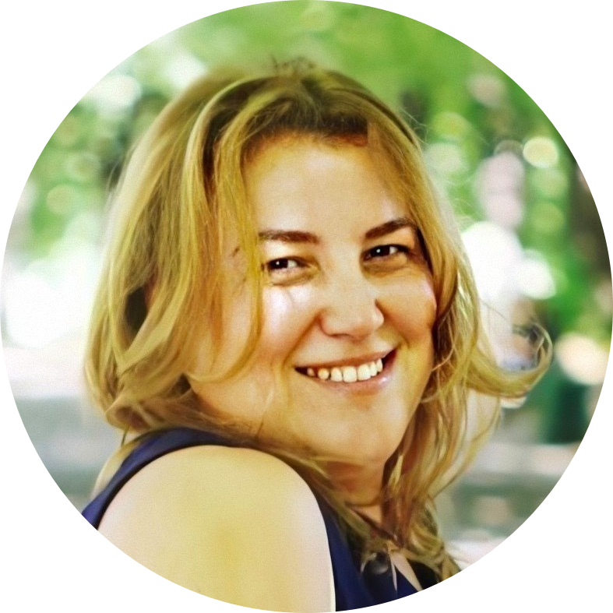
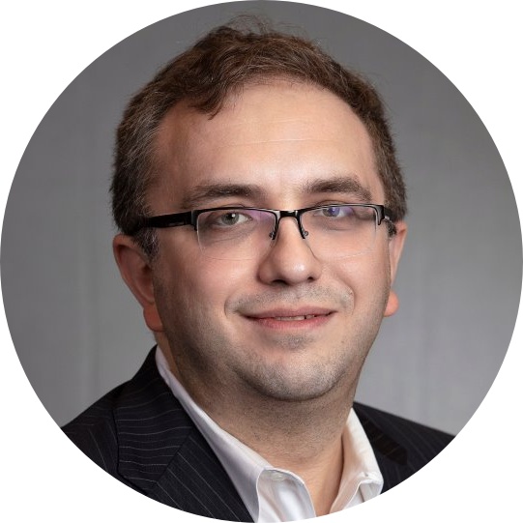
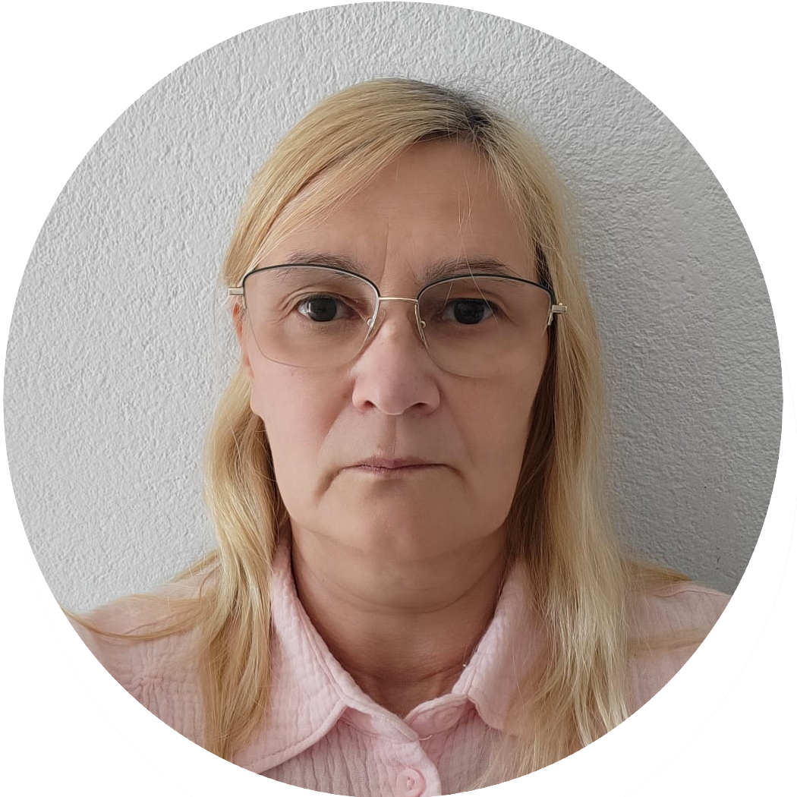
CORE Team
10
CEO Helen Martsynishena
CTO Nina Fedosova
CFO Boris khazin
An experienced technology executive with 20+ years of experience delivering complex AI and intelligent automation solutions across Banking, Retail, Software, and High-Tech industries.
Excels in leading global teams, driving business growth.
Graduate of Master’s degree from Arizona State University (Ira A. Fulton Schools of Engineering).
Seasoned executive and board advisor with over 20 years of leadership experience in governance, risk, compliance (GRC), cybersecurity, and AI-driven digital resilience.
Has a proven track record of guiding global enterprises and fintech startups through complex regulatory landscapes, technology transformation, and operational scaling.
Successfully built and scaled multimillion-dollar GRC practices, launched award-winning financial products, and pioneered AI-based compliance solutions in collaboration with industry leaders like Google and Microsoft.
AI architect and expert with extensive experience in developing mathematical models and integration solutions. Author of scientific publications and holder of the OPEN Group Certified Architect certification. Graduate of Saint Petersburg State University.

Slide 18

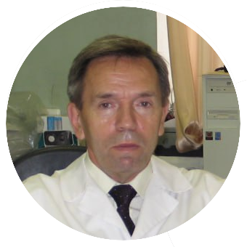
Advisor
Professor and Doctor of Science with over 25 years of expertise in medical diagnostics and oncology research. Scientific lead for medical AI projects, author of numerous scientific publications, and co-author of patents.
Graduate of Sechenov First Moscow State Medical University.
Speaker at multiple conferences. Author of multiple publications.

Slide 19

Conferences presentations
Berchenko G., Fedosova N.
SICOT 2024 Belgrad
Mathematical model of neural network for quantitative determination of tumor proliferative activity based on the expression of Ki-67 antigen development
Fedosova N.
Hungary, Budapest, 2019
IBM Central Europe Leadership Event
using IBM Power AI Vision in oncology diagnostic
Berchenko G., Fedosova N.
SICOT 2017 Muscat
Digital technologies in the differential diagnosis of benign and malignant bone tumors

Slide 20
Our publications
Berchenko, G. N., Fedosova, N. V., Kochan, M. G., & Mashoshin, D. V. (2024). Neural network model development for detecting atypical mitoses in histological slides. N.N. Priorov Journal of Traumatology and Orthopedics, 31(3), 337–349. https://doi.org/10.17816/vto626361
Fedosova, N. V., Berchenko, G. N., Shugaeva, O. B., Mashoshin, D. V., & Kochan, M. G. (2024). The influence of CNN architecture, image size and quality to object detection model on histological specimens. N.N. Priorov Journal of Traumatology and Orthopedics, 31(4).. https://doi.org/10.17816/vto637087
Fedosova, N. V., Berchenko, G. N., & Mashoshin, D. V. (2021). Development of the mathematical model neural network for morphological assessment of repair and remodeling of bone defect. Mathematical Modeling, 33(9), 22–34. https://doi.org/10.20948/mm-2021-09-02
Berchenko, G. N., Braylovskya, T. V., Fedosova, N. V., & Tangieva, Z. A. (2021). Application of neural network for morphological assessment of revascularized autograft remodeling at the stage of implant placement in jaw defects. Parodontologiya, 26(3), 188–196. https://doi.org/10.33925/1683-3759-2021-26-3-188-196
Contact our side to get more information about our publications:
https://www.megaitex.com/

Slide 21
Financial
11
Ask 4.250 M + clinical trial costs for 2 years run rate.
Run rate $176k a month.
P&L $25 | Year 01 | Year 02
Total | $ (2,028,000) | $ (336,000)

Slide 22

Thank you
Feel free to contact us in case of any questions: Sales@MegAITex.com
Our site https://www.megaitex.com/

Slide 23
Appendix

Slide 24
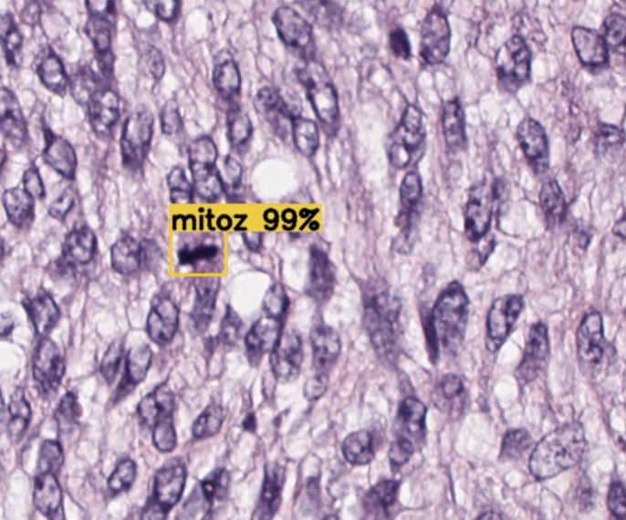
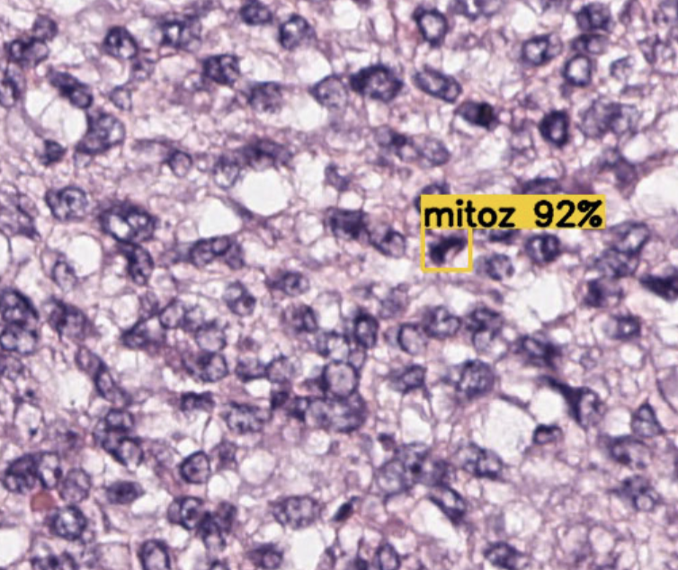
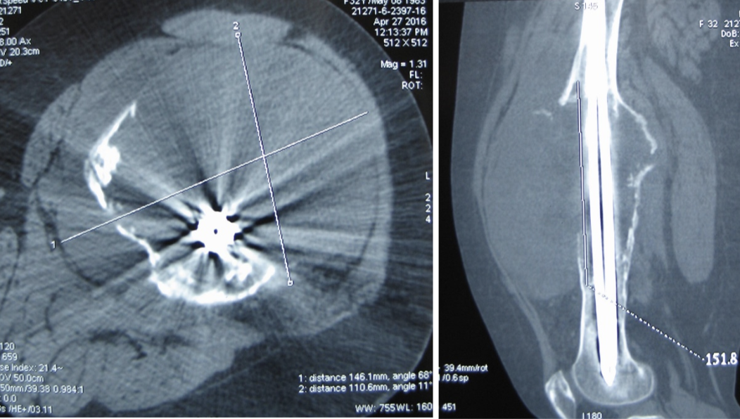
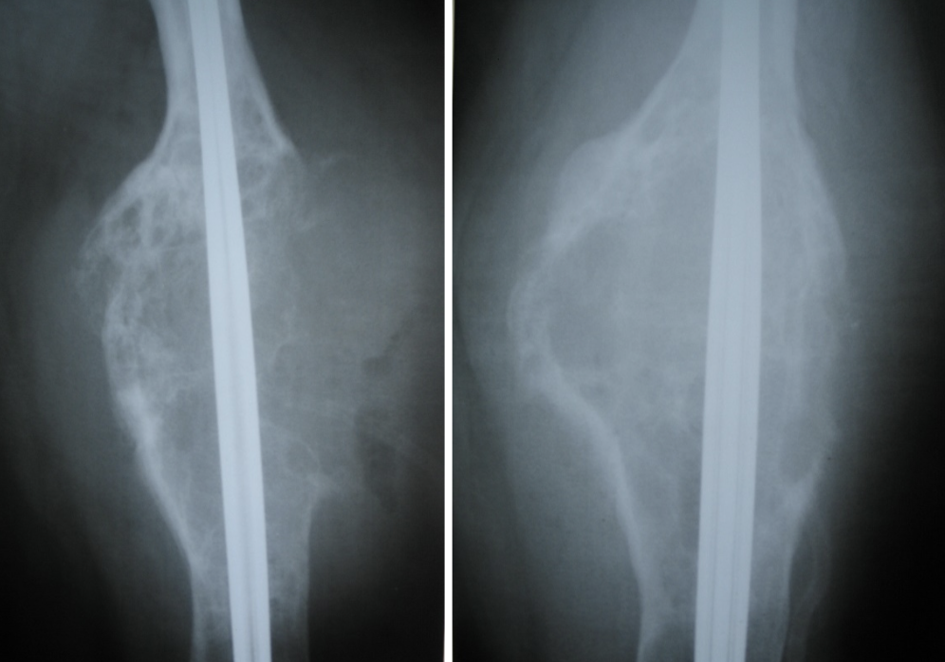
Patient case
CHALLENGE
33-year-old woman with femur pain & tumor growth
Initial biopsy misinterpreted as benign (fibrous dysplasia)
Years later: tumor progression → confirmed osteosarcoma G2
Multiple expert pathologists disagreed on diagnosis
Subtle pathological mitoses difficult to detect manually
Pathologists (with 26 & 37 years of experience) vs MegAITex
Multiple pathologists’ reviews led to conflicting conclusions: some diagnosed benign conditions (bone callus, reactive osteogenesis), others suspected malignancy.
Histology showed atypical mitoses, but very rare and difficult to verify.
Immunohistochemistry: mixed results, with some markers positive and others negative.
AI Model detected pathological mitoses with 92/99% probability.
AI allowed agreement between different diagnosis

Slide 25


High-level user flow
User Interface
AI (Math) module
Authorized user
uploads images
Prepare images for processing by the model (removing unnecessary information)
The model searches for specified objects – atypical mitoses – and determines their probability
Upload data
for AI processing
Data Post-Processing*
AI module*
User can view and
download results
Creates a summary of the analyzed case
Highlights the detected mitoses in the original image, checks the quality of the images (they do not overlap each other)
Data Results preview
Data Post-Processing*
Archive
data
* MegAITex Intellectual Property

Slide 26
development roadmap
MVP (completed):
Proven Technology
Release 1:
Near-Term Execution
Release 2:
Long-Term Scale
4 months after receiving funds
13 months after receiving funds
Analyze images in SVS format and detect pathological mitoses
Get annotated results and save them in JPG/TXT format
Current model characteristics:
Precision = 96%
Recall = 98%
Accuracy = 97%
Secured Data Processing
Role Based access
Preprocessing model optimization (ongoing)
Performance improvement (ongoing)
Regulatory & compliance required certification is obtained
Clinical trial estimated completion 3-4 months
Real time analyze images and detection pathological mitoses
Multiple data source support:
Direct real-time connection to optical microscopes
Multiple models specification for various cancer support
Begin developing models for detection of new deceases (for example - Polypheration index (Ki-67).

Slide 27
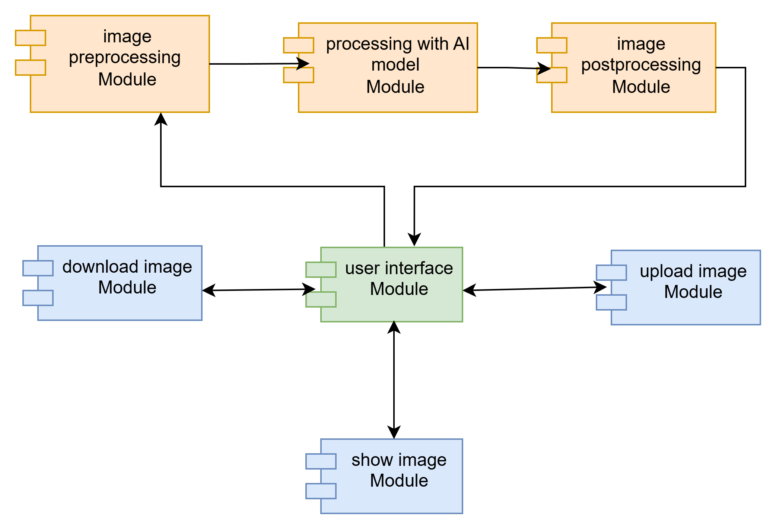
Architecture schema

Slide 28
planned team
 | Role Description | Planned workload | Availability | MVP, FTE | Release 1, FTE | Release 2, FTE
Development team
Product Owner | Product development | Part time | Boris | 0.5 | 0.5 | 0.5
Delivery Manager | Delivery and team coordination | Full time | Helen | 1 | 1 | 1
Solution Architect | Architecture definition | Full time | Nina | 1 | 1 | 1
Business Analyst | Requirements development | Full time | to be hired | - | 1 | 1
Development Team Leader |  | Full time | Misha | 1 | 1
Developer | Back End and ML development | Full time | to be hired | - | 2 | 2
UX/UI Developer | Front End Development | Full time | to be hired | 0.5 | 1 | 1
Subject Matter Expert | Data Markup | Full time | to be hired | - | 1 | 1
Subject Matter Expert | Model Testing | Full time | to be hired | - | 1 | 1
Quality Engineer | Product testing | Full time | to be hired | - | 1 | 2
DevOps Engineer | Product deployment | Part time | to be hired | - | 0.5 | 0.5
Security Engineer | Setup and validate product security | Part time | If needed | - | 0.5 | 0.5

Slide 29
planned team
 | Role Description | Planned workload | Availability | MVP, FTE | Release 1, FTE | Release 2, FTE
Support team
Support Engineer (L1), MX | L1 end users support | Full time | to be hired | - | 1 | 1
Support Engineer (L1), US | L1 end users support | Full time | to be hired |  | - | 1
Support Engineer (L2/L3), MX | L2/L3 end users support | Full time | to be hired | - | 1 | 1
Support Engineer (L2/L3), US | L2/L3 end users support | Full time | to be hired | - | - | 1
Other
Sales Specialist (MX) | Sales and Marketing | Full time | to be hired | - | 1 | 1
Sales Specialist (US) | Sales and Marketing | Full time | to be hired | - | - | 1
Head of Compliance |  | Part time | Boris | 0.5 | 0.5 | 0.5
Compliance Specialist, MX | Compliance and Regulatory | Full time | to be hired | - | 1 | 1
Compliance Specialist, US | Compliance and Regulatory | Full time | to be hired | - | - | 1
Clinical Affairs Specialist, MX | Coordination with clinics in MX | Full time | to be hired | - | 1 | 1
Clinical Affairs Specialist, US | Coordination with clinics in US | Full time | to be hired | - | - | 1

Slide 30
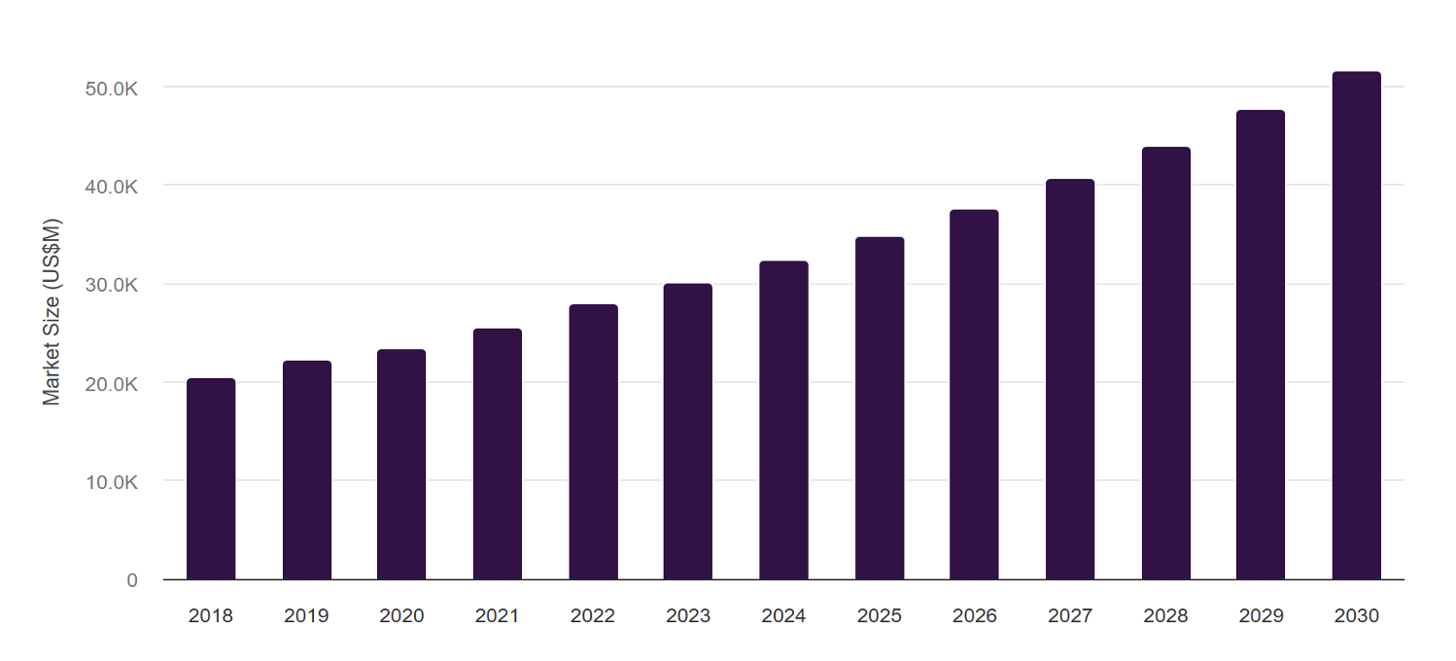
GLOBAL Market opportunities
Growing demand for digital pathology and AI solutions in healthcare.
Increasing volume of biopsy studies and need for faster, more accurate diagnostics.
Lack of industrial-grade AI tools for histopathological image analysis creates a significant market gap.
GLOBAL CANCER BIOPSY MARKET, 2018-2030 (US$M)*
OUR CONSUMERS
Medical institutions specializing in diagnostics
Manufacturers of medical equipment and analytical systems
Research medical institutions
* Grand View Horizon

Slide 31
Financial model, use of funds, and milestones
Total Funding Request: $4.25 million + clinical trial fees for 2 years of operational run rate
Monthly Run Rate: Approximately $176,000 with scaling fixed and variable costs
Expected Break-even: Targeted at 18-24 months post funding, aligned with Mexico-only market launch
Client Growth: Ramp from 0 to 10,000 cases per month within 24 months
Per-case Economics: $25 revenue; $8.40 gross margin at scale
Strategic Partnerships: Supported by key alliances and regulatory engagements
Financial Health
Early investment phases correspond to operating losses driven by R&D and regulatory compliance costs
Positive EBITDA expected to commence by month 19-24 as volume and margins increase
Efficient capital allocation targets accelerate payback and sustainable growth

Slide 32
Mexico: Per‑Case Inputs & Formulas
Use of Proceeds
Input | Assumption (Edit) | Notes / Formula
Per‑case price (USD) | $25 | Varies by indication and volume
Platform fee / site / month | Jira for workflow process | Base SaaS to cover support & roadmap
Avg. cases per site / month | 250-500 cases
Compute per WSI | $1500 fixed cost per location | Inference GPU/CPU; batching reduces cost
Storage per WSI / retention | $ if need cloud storage | Warm/cold storage; retention policy
Clinician QA time | 4 min | Minutes × loaded cost = QA cost/case
Support & CSM allocation | $3000 monthly per 150 case problems a month (L1, upgrade and if needed data retrieval) | Monthly support $ / cases = support/case
Gross margin / case | Auto | = (Price − variable costs − alloc. support) / Price
Milestone | Spend ($) | Timing | Outcome KPI
Clinical trial(s) & validation (v1) | Up to $1,750,000 | Q4’25–Q2’26 | Regulatory dossier ready; sensitivity/specificity targets met
Regulatory submissions (e.g., COFEPRIS MX; U.S. path) | $438,000 | Q2’26–Q3’26 | Clearance in MX; U.S. submission filed
Productization (bundle: Ki‑67 + mitoses + QA) | $495,000 | Q2’26–Q4’26 | Bundle GA; FP burden ↓; faster reads
Commercial build (sales, CSM, KOLs) | $20,000 | Q3’26–Q4’26 | First 10–20 logos; NRR > 100%
Scale ops (support, monitoring, QMS) | $200,000 | Q4’26–Q1’27 | ARR ≥ $3,000,000; GM ≥ 33.6%; (at 10000 a month cases)

Slide 33
Financial
 | Months | 02 | 03
Fixed costs | 01 | 02 | 03 | 04 | 05 | 06 | 07 | 08 | 09 | 10 | 11 | 12 | 13 | 14 | 15 | 16 | 17 | 18 | 19 | 20 | 21 | 22 | 23 | 24
Technology Development | $70,000 | $70,000 | $70,000 | $70,000 | $70,000 | $70,000 | $85,000 | $85,000 | $85,000 | $85,000 | $85,000 | $85,000 | $85,000 | $85,000 | $85,000 | $85,000 | $85,000 | $85,000 | $40,000 | $40,000 | $40,000 | $40,000 | $40,000 | $40,000
Sales & Marketing | $5,000 | $5,000 | $5,000 | $5,000 | $5,000 | $5,000 | $5,000 | $5,000 | $5,000 | $5,000 | $5,000 | $5,000 | $5,000 | $5,000 | $5,000 | $5,000 | $5,000 | $5,000 | $5,000 | $5,000 | $5,000 | $5,000 | $5,000 | $5,000
Compliance & Regulatory | $6,000 | $6,000 | $6,000 | $6,000 | $6,000 | $6,000 | $6,000 | $6,000 | $6,000 | $6,000 | $6,000 | $6,000 | $6,000 | $6,000 | $6,000 | $6,000 | $6,000 | $6,000 | $6,000 | $6,000 | $6,000 | $6,000 | $6,000 | $6,000
Operations | $95,000 | $95,000 | $95,000 | $95,000 | $95,000 | $95,000 | $95,000 | $95,000 | $95,000 | $95,000 | $95,000 | $95,000 | $95,000 | $95,000 | $95,000 | $95,000 | $95,000 | $95,000 | $95,000 | $95,000 | $95,000 | $95,000 | $95,000 | $95,000
Total | $176,000 | $176,000 | $176,000 | $176,000 | $176,000 | $176,000 | $191,000 | $191,000 | $191,000 | $191,000 | $191,000 | $191,000 | $191,000 | $191,000 | $191,000 | $191,000 | $191,000 | $191,000 | $146,000 | $146,000 | $146,000 | $146,000 | $146,000 | $146,000
Category | 01 | 02 | 03 | 04 | 05 | 06 | 07 | 08 | 09 | 10 | 11 | 12 | 13 | 14 | 15 | 16 | 17 | 18 | 19 | 20 | 21 | 22 | 23 | 24
Number of clients | 0 | 0 | 0 | 0 | 0 | 250 | 500 | 750 | 1000 | 1250 | 1500 | 2000 | 2500 | 3000 | 3500 | 4000 | 4500 | 5250 | 6000 | 6750 | 7500 | 8250 | 9000 | 10000
Revenue | $25 | $25 | $25 | $25 | $25 | $25 | $25 | $25 | $25 | $25 | $25 | $25 | $25 | $25 | $25 | $25 | $25 | $25 | $25 | $25 | $25 | $25 | $25 | $25
Variable cost | $0 | $0 | $0 | $0 | $0 | $250 | $500 | $750 | $1,000 | $1,250 | $1,500 | $2,000 | $2,500 | $3,000 | $3,500 | $4,000 | $4,500 | $5,250 | $6,000 | $6,750 | $7,500 | $8,250 | $9,000 | $10,000
Total | $0 | $0 | $0 | $0 | $0 | $6,000 | $12,000 | $18,000 | $24,000 | $30,000 | $36,000 | $48,000 | $60,000 | $72,000 | $84,000 | $96,000 | $108,000 | $126,000 | $144,000 | $162,000 | $180,000 | $198,000 | $216,000 | $240,000
P&L | 01 | 02 | 03 | 04 | 05 | 06 | 07 | 08 | 09 | 10 | 11 | 12 | 13 | 14 | 15 | 16 | 17 | 18 | 19 | 20 | 21 | 22 | 23 | 24
Total | ($176,000) | ($176,000) | ($176,000) | ($176,000) | ($176,000) | ($170,000) | ($179,000) | ($173,000) | ($167,000) | ($161,000) | ($155,000) | ($143,000) | ($131,000) | ($119,000) | ($107,000) | ($95,000) | ($83,000) | ($65,000) | ($2,000) | $16,000 | $34,000 | $52,000 | $70,000 | $94,000

